Slide 1
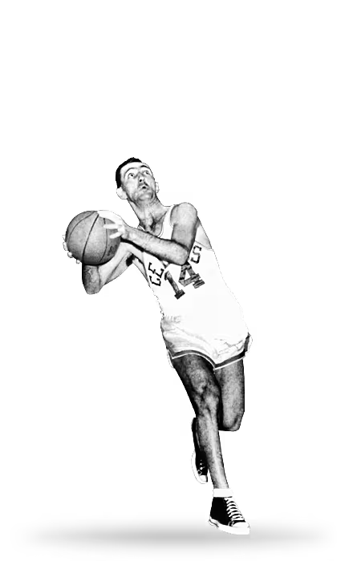
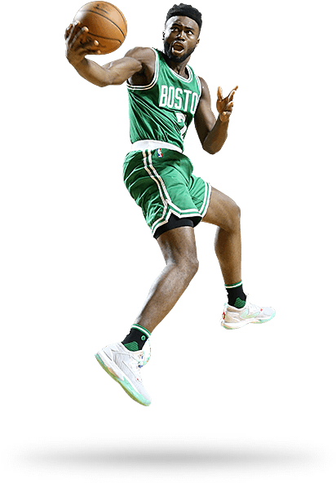
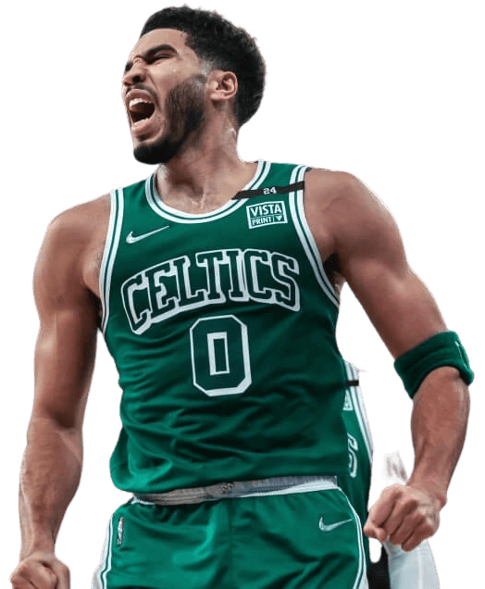
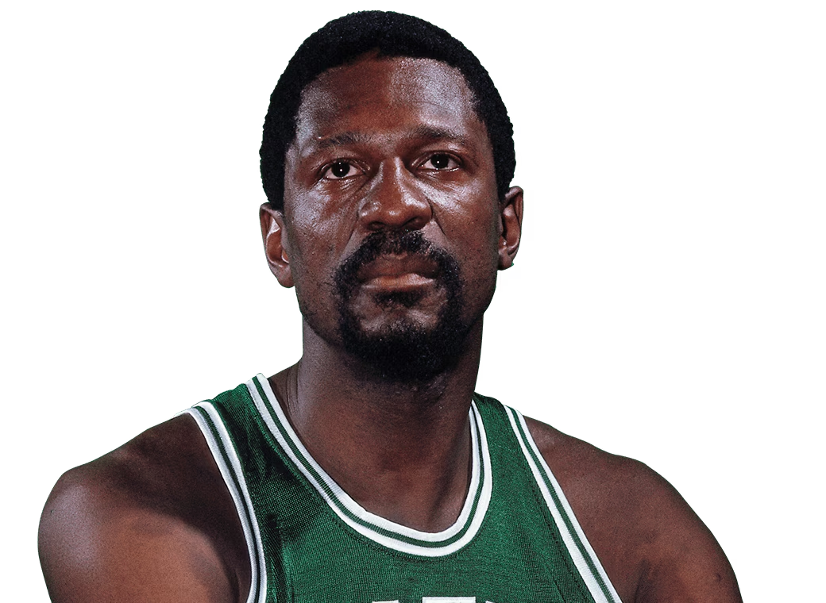
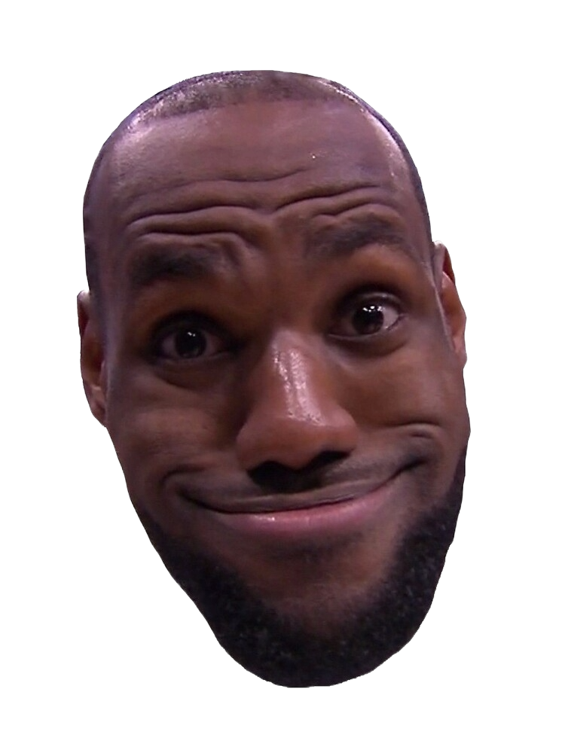
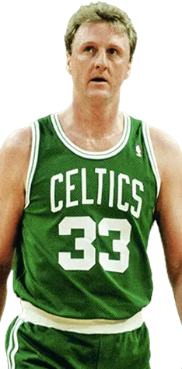

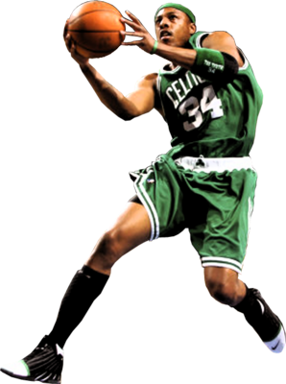
DSB-521 Capstone:
Celtics Player Classifer
By Connor Finnerty

Slide 2
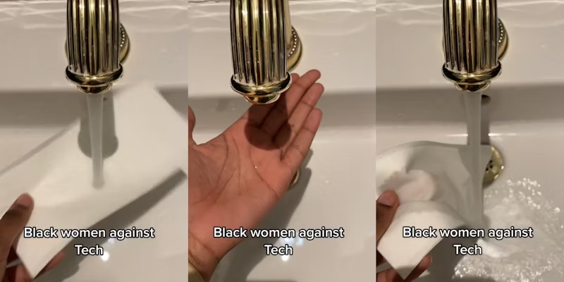
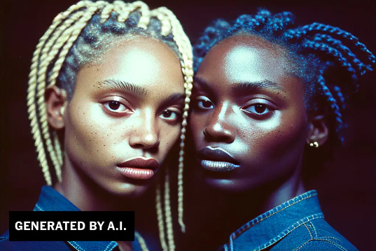
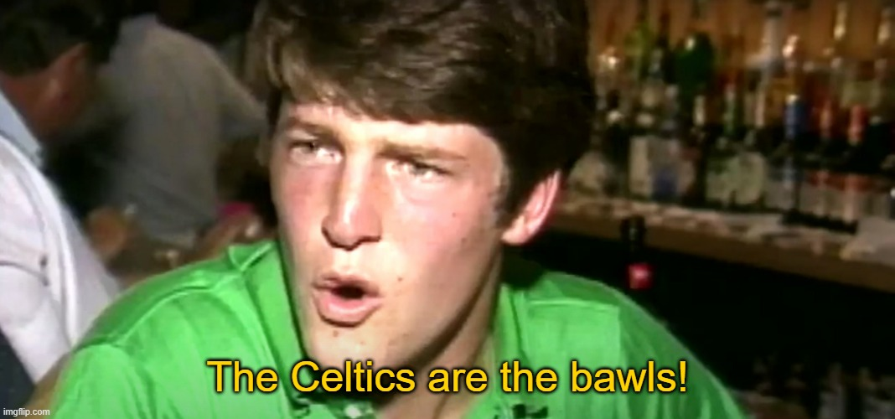
Introduction
Purpose:
Develop personal data science techniques/strategy
Create a functional model when access to data may be limited
Extract information from image to augment lack of training data through workarounds
Cross-reference machine vision outputs & publicly available web data
Broader social implications
Machine vision models tend to perform worse on people of African descent
Trained models on visual datasets composed of majority Black persons (NBA players 74% Black) can provide info for improving visual models
Personal
My dad and I loved watching the Celtics
Basketball is neat (The Celtics are the bawls)

Slide 3
Overview of approach
YOLOv8 bounding box cropping of most salient identified person
Training MobileNetv2 Classifier using uncropped & uncropped images
BeauSoup scrape of all Celtics roster data, 1954-2024
easyOCR to extract jersey number, compared to roster data for given season

Slide 4
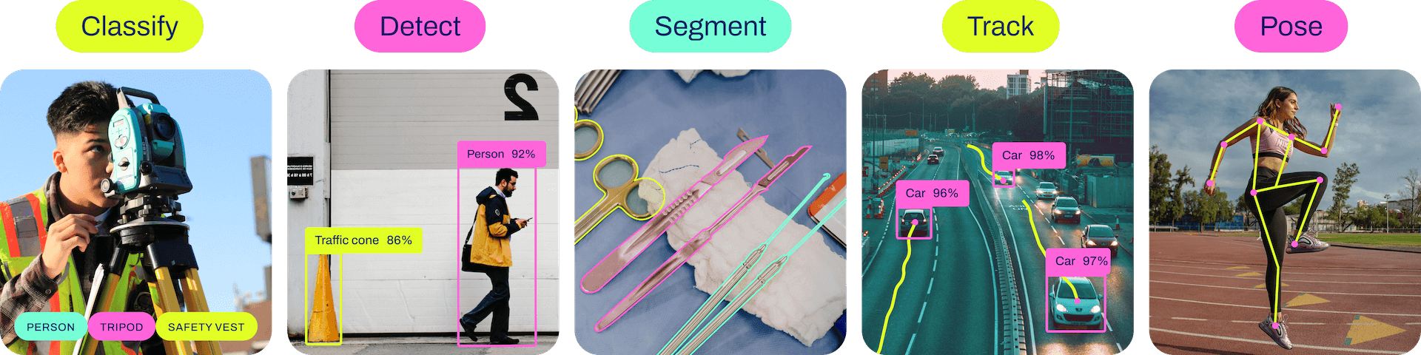
YOLO (You Only Look Once) v8
Published by Ultralytics, YOLO is designed for a wide range of object detection and tracking, instance segmentation, image classification and pose estimation tasks.
Has become a valuable preprocessing tool for many visual learning tasks
Allows persons to be distinguished from objects (eg. basketballs, hoops, etc.) so that persons may be labeled or extracted for further learning

Slide 5
Data Collection and Cleaning
Training set consisted of ~400 Celtics images and ~400 non-Celtics images
Manually acquired (no imageset for this problem previously existed)
~30 images from each set couldn’t be loaded w/ TensorFlow
~20 images from each set were mislabeled by YOLO (manually removed)
Curious note: most common mislabeling was white fan and black player
667 uncropped images, 596 cropped images

Slide 6
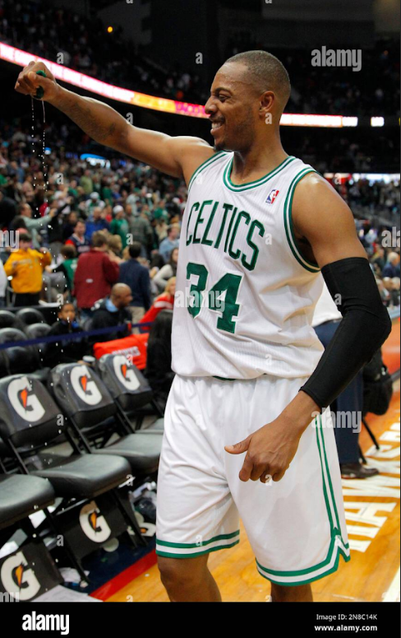
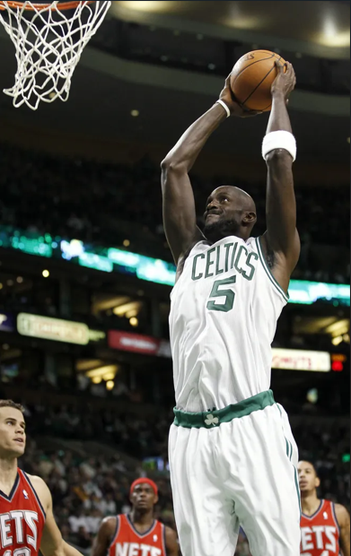

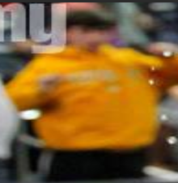
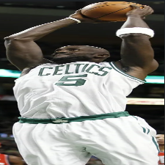

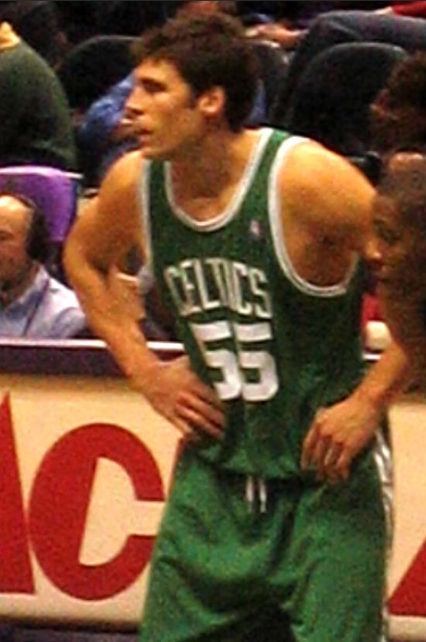
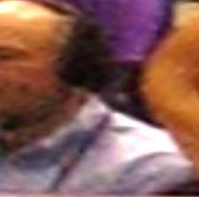
YOLO Examples

Slide 7
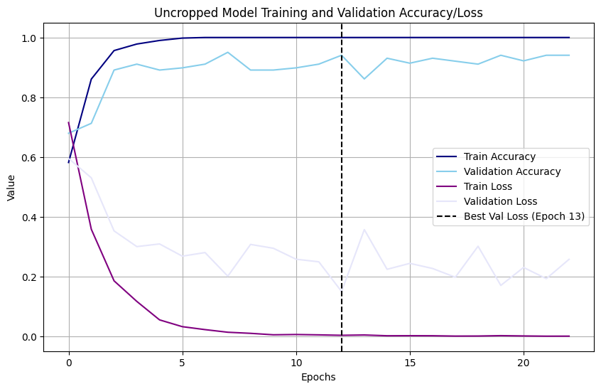
MobileNetv2 Trained Model Performance
Train Acc: 1.0000
Train Loss: 0.0038
Val Acc: 0.9406
Val Loss: 0.1504

Slide 8

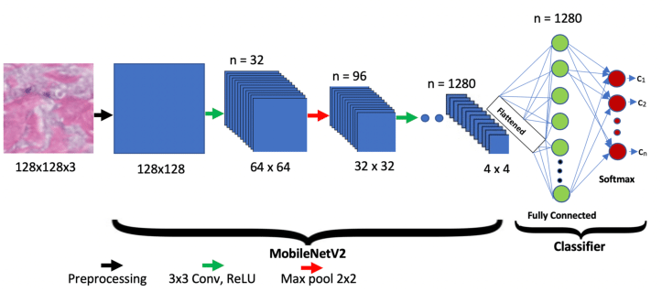
MobileNetv2 Pre-Trained Model
Developed by Google AI researchers in 2019, MobileNetv2 is designed to reduce processing load while maintaining performance
Can be combined with dense CNN layers to tailor outputs to specific classifications and predictions

Slide 9
EasyOCR for Identifying Player Jersey Numbers
Loaded model to test on novel Celtic and Non-Celtic images
Performed stunningly well (~95% accuracy in informal testing)
Loaded Model into Streamlit App
Used YOLOv8 to Preprocess and Isolate Players in Streamlit Images
Implemented EasyOCR, a deep-learning Optical Character Recognition model, on cropped images of players
Coded to extract and concatenate all identified digits, cross-referenced against player numbers in BBRef-scraped roster data
If player identified as a Celtic, jersey number is attempted to be identified. If successful, player name and URL to BBRef page are generated

Slide 10
Link to Streamlit App
https://b352-34-73-244-241.ngrok-free.app/

Slide 11
Limitations
Data Collection
Datasets not readily available
Star players are easier to find isolated pictures
MobileNetv2
Multiple training iterations (with new data) always caused overfitting issues
Unfreezing and training even top ~5 layers can cause major performance loss
EasyOCR
Struggles with 4s and 7s, and cannot distinguish 0s from letter O without domain-specific training
Many NBA teams use novel fonts, which must be trained on before EasyOCR performance is reliable

Slide 12
References
https://www.nytimes.com/2023/07/04/arts/design/black-artists-bias-ai.html
https://circuit.bcit.ca/repository/islandora/object/repository%3A2043/datastream/PDF/download/citation.pdf
https://www.statista.com/statistics/1167867/nba-players-ethnicity/
https://www.dailydot.com/irl/sink-faucet-racial-bias/
https://github.com/ultralytics/ultralytics
https://arxiv.org/abs/1801.04381

